Slide 1
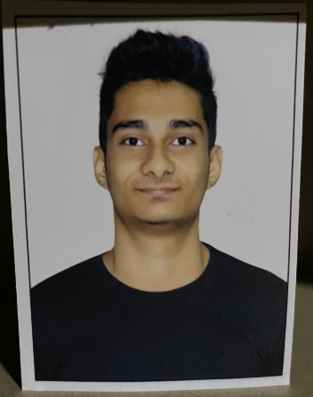
Vinit Vasant Panchal
Trainee Software Engineer
Mobile : 9702955094
Email: Vinit.Panchal@mastek.com
LinkedIn:(Vinit Panchal) | LinkedIn
Educational Qualification: BSc IT
CGPA/Overall Score: 7.22
University: Mumbai University
Technical Skills: C ,C++, Python, Dot Net, Html, CSS, JavaScript. Domain Knowledge: E-commerce
Behavioural Trainings Completed:
NA Technical Trainings/Certifications:Angular 13, ASP.NET MVC, ASP.Net API, SQL server, HTML, CSS, JavaScript, Bootstrap
Academic Project Details
Problem Statement: There was no proper system for Online Auction.
Solution Summary: To solve this issue we created a system that was designed to allow users to set up their products for auctions and bidders to register and bid for various products available for bidding.
Technology used: Dot net framework( Asp.net, C#), SQL server, HTML, CSS, and JavaScript.
Outcome: Developed an online auction system which provided a forum for sellers to meet and interact with buyers and sell items to interested bidders.

Slide 2
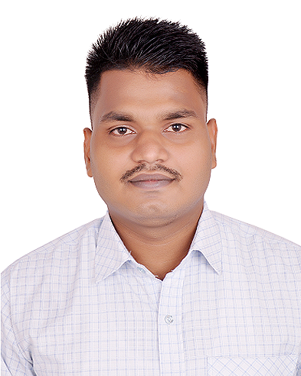
Ganesh Machindra Veer
Trainee Software Engineer
Mobile : 8655524080
Email: Ganesh.veer@mastek.com
Linkedin: linkedin.com/in/ganesh-veer-35616015a
Educational Qualification: MSc (Information Technology)
CGPA/Overall Score: 72%
University: University of Mumbai
Technical Skills: HTML, CSS, JavaScript, Angular, C#, SQL, Python.
Domain Knowledge: Education
Behavioural Trainings Completed: GDPR, POSH, Anti Bribery, Info sec
Technical Trainings/Certifications:
Full Stack – UI Layer
Full Stack – Cloud Layer
Full Stack – DevOps Layer
Full Stack – Storage Layer
Full Stack – Middleware Layer
Academic Project Details
Problem Statement: After completing graduation students need job but they don’t know what to do next, hence I decided to develop this project.
Solution Summary: Project’s aim was to give simplicity in the selection process which is done by the colleges and companies person easily and providing good employees to companies
Technology used : Front-end Tool:- VS 2015(asp.Net).
Back end Tool:- SQL Server Management Studio.
Outcome: This system was used for Campus Selection for University and Companies.

Slide 3
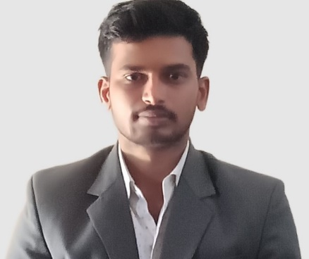
Mahesh Sitaram Popale
Trainee Software Engineer
Mobile : 7447267462
Email: Mahesh.Popale@mastek.com
Linkedin: https://www.linkedin.com/in/mahesh-popale-b5064b205
Educational Qualification: MCA(Master Of Computer Applications )
CGPA/Overall Score: 7.504
University: Savirtribai Phule Pune University, Pune
Technical Skills: HTML, CSS, JavaScript, Angular13, ASP.Net MVC,Web Api, Sql, Microsoft Azure, PostgresSql, Sql
Domain Knowledge: E-commerce
Behavioural Trainings Completed:
Cultivating a Consulting Mind-set.
Technical Trainings/Certifications:
Microsoft Certified: Azure Developer
Associate, Azure Fundamentals
Full Stack Foundation
Academic Project Details
Problem Statement: Online Jewellery Shopping System
In Todays World customers prefer to purchase Online than visiting to shop.
Solution Summary: Interactive GUI provided for customers. Customers were able to search, manage products, manage profiles and make online payments online with payment gateway.
Technology used: HTML, CSS, JavaScript, Bootstrap 4,
PHP,MSQL
Outcome: Attractive and Responsible GUI for customers. Customers could manage products, orders and profiles, customers could make the payment online with debit/credit card. Admin could manage the customers and admin functionalities.

Slide 4
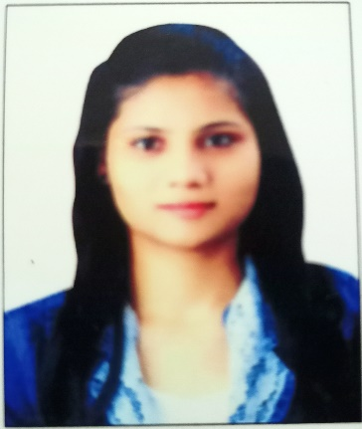
Sayali Sachin Dhonnar
Trainee Software Engineer
Mobile : 8010838237
Email: Sayali.Dhonnar@mastek.com
Linkedin:
Educational Qualification: BE (Computer Science)
CGPA/Overall Score: 9.27
University: Solapur University
Technical Skills: Angular, Android, SQL, Java, Dot net, HTML,CSS,JS,​
Bootstrap .​
Domain Knowledge: Healthcare
Behavioural Trainings Completed:
GDPR, POSH, Anti Bribery, Info sec
Technical Trainings/Certifications:
Academic Project Details
Problem Statement: An application was needed to simply Blood banks and connect donors and blood banks.
Solution Summary: The main purpose of this project was to interconnect all the blood banks, hospitals, blood donors into a single network . This android application was developed to simplify search for blood in nearby areas for emergency.
Technology used: Android ,PHP, Json
Outcome: The Android Application : This Application present the blood bank mgmt. system related issues. It shows nearby blood banks and their stock.

Slide 5
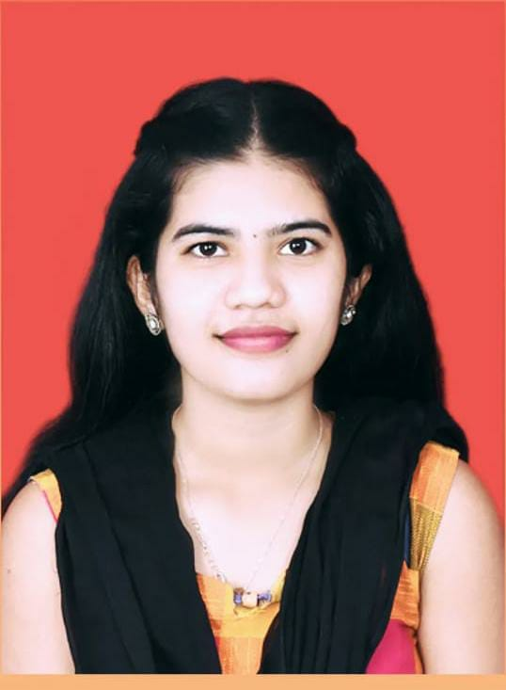
Full Name
Photo Here
(Face to cover 50% of the box)
No Facebook Pics
Trainee Software Engineer
Mobile : 8237887067
Email:Pranali.Parange@mastek.com
Linkedin: www.linkedin.com/in/pranali-parange-6a0925169
Educational Qualification:BE -EXTC
CGPA/Overall Score: 6.9
University: Mumbai University
Technical Skills: React,JavaScript,Html
,CSS,Bootstrap,Java,SQL
Domain Knowledge: E-commerce
Behavioural Trainings Completed:
Cultivating a Consulting Mind-Set
Technical Trainings/Certifications:
OCC Training,Full Stack Developer,
React Training.
Academic Project Details
Problem Statement: Online yoga portal nowadays Offers Flexible Scheduling For Busy Learners & More Affordable than
In-person Training.
Solution Summary: Users were able to attend remote
trainings with ease and accessibility
Technology used:Java,Restful Services, Spring Boot,
HTML,CSS,Bootstrap,MySQL
Outcome: Online yoga portal provides various features to users which are beneficial to health. This application contains different Modules like Administrator, User, Trainer. Each module has Different Functionality.

Slide 6
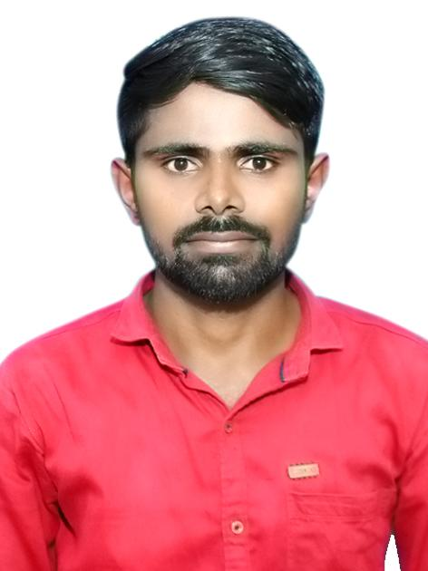
Madhav Ramrao Tengetol
Trainee Software Engineer
Mobile : 9637063568
Email: Madhav.Tengetol@mastek.com
LinkedIn:
Educational Qualification: B.E.
CGPA/Overall Score: 8.38
University: Savitribai Phule Pune University
Technical Skills: .NET, Angular, JavaScript, AWS, Oracle, PostgreSQL
Domain Knowledge: E-commerce
Behavioural Trainings Completed:
GDPR, POSH, Anti Bribery, Info sec
Technical Trainings/Certifications:
Angular & Nodejs The MEAN Stack guide by UDEMY
Learn SQL using PostgreSQL
Academic Project Details
Problem Statement: A good application was needed to solve issues of buying and selling of goods.
Solution Summary: Built an application that solved issue in Buying and selling of goods and services, or the transmitting of funds or data, over the internet
Technology used: Angular, PostgreSQL, .NET
Outcome: Built an e-commerce Floweriest app for users

Slide 7
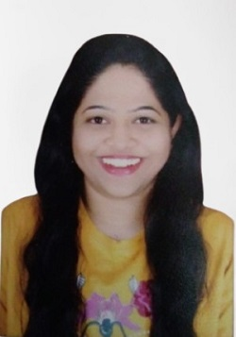
Sonali Dattatray Bhagyawant.
Photo Here
(Face to cover 50% of the box)
No Facebook Pics
Trainee Software Engineer
Mobile :9867911795
Email:Sonali.Bhagyawant@mastek.com
Linkedin:
EducatiQualificationonal :B.E.COMPUTER
CGPA/Overall Score:6.5
University: Mumbai University
Technical Skills:Html,css,Javascript,C,C#,Angular,Postgressql,SqlServer,Windows,
Bootstrap,MVC,WEBAPI,ASP.NET CORE
Domain Knowledge:Web Application
Behavioural Trainings Completed:
GDPR, POSH, Anti Bribery, Info sec​
Technical Trainings/Certifications:
HTML,Angular,C#,Postgress,WEBAPI
Academic Project Details
Problem Statement:The major aim is to design a honeypot to expose the identity of the attacker and understand and analyze the behavior of the
attacker.
Solution Summary:We have analyzed the various functions features and uses of a honeypot.
Only tracks the identity of attacker through the network and
not contains personal data.
Technology used: Honeypot,ASP.NET,SQL
Outcome: Honeypot concept is used over a webserver to track the attacker and identify the pattern of attack.

Slide 8
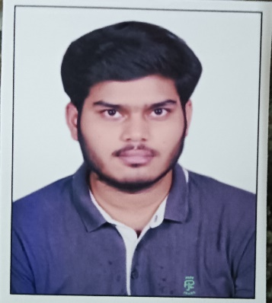
Siddharth Arvind Kumar Singh
Trainee Software Engineer
Mobile : 8070216971
Email:Siddharth.Singh2@mastek.com
LinkedIn:(18) Siddharth Singh | LinkedIn
Educational Qualification: BSc IT
CGPA/Overall Score: 9.1
University: Mumbai University
Technical Skills: C ,C++, Python, Java, Dot Net, PHP, Html, CSS, JavaScript, Java, AWS Domain Knowledge: Education
Behavioural Trainings Completed: Anti Bribery, InfoSec, GDPR, POSH
Technical Trainings/Certifications: Angular 13, ASP.NET MVC, ASP.Net API, SQL server, HTML, CSS, JavaScript, Bootstrap, Public Cloud (Aws, Azure, GCP)
Academic Project Details
Problem Statement: There was no proper system for storing data and it was all managed in excel sheets.
Solution Summary: Our previous marking system was Excel sheets, and they designed the results format using them.
My project simplified the process and stored the data and retrieved the data based on Roll no.
Technology used: Dot net framework( Asp.net, C#), SQL server, AJAX controls, HTML, CSS, and JavaScript
Outcome: Designed the format of result and saved the marks in databases. Based on roll no all the student data could be fetched and we could also print the results.
Technology used: Java And AWS

Slide 9
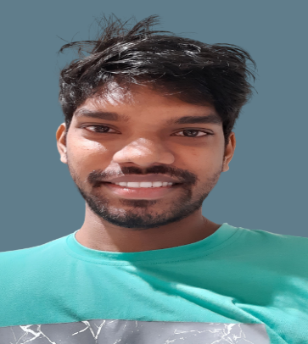
Ashwinkumar Jaiswar
Photo Here
(Face to cover 50% of the box)
No Facebook Pics
Trainee Software Engineer
Mobile :9022373100
Email:ashwink15403@mastek.com
Linkedin: https://www.linkedin.com/in/ashwinkumar-jaiswar-3ab200254
Educational Qualification: MSc.IT
CGPA/Overall Score:8.92
University: Mumbai University
Technical Skills: Azure, Dot NET, Angular, Python, Node js, HTML, CSS, Javascript, SQLServer, PostgreSQL, Bootstrap, Jquery
Domain Knowledge: AI/Automation
Behavioural Trainings Completed:
E-mail Etiquette, Verbal communication
Technical Trainings/Certifications:
Microsoft Certified: Azure Developer Associate, Microsoft Certified: Azure Fundamentals ,
Academic Project Details
Problem Statement: Project Name-Speech Emotion Recognition (SER)-When we are provided with less data to train. it produces low accuracy.
Solution Summary: We provided more data for training for higher accuracy.
Technology used: Python, Excel, HTML, CSS
Outcome: Taking input from the user based on input it provided emotions like neutral, calm, happy, sad, angry, fearful, disgust, surprised.

Slide 10
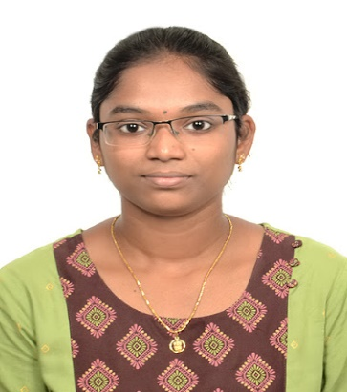
Lakshmi Thirupathamma Gundala
Photo Here
(Face to cover 50% of the box)
No Facebook Pics
Software Engineer
Mobile : 6281447935
Email: Lakshmi.Gundala@mastek.com
Linkedin: https://www.linkedin.com/in/lakshmi-gundala-b129521a1/
Educational Qualification: B-Tech in Computer Science Engineering(CSE).
CGPA/Overall Score:8.89
University: Qis College Of Engineering And Technology, JNTUK University.
Technical Skills: Java 8,Spring,Spring-boot,Spring-MVC, Rest-API’s, JSP &Servlets, Hibernate, Python, HTML, CSS.
Domain Knowledge:Machine-Learning
Behavioural Trainings Completed:
Anti-Bribery,POSH,GDPR,InfoSec.
Technical Trainings/Certifications:
Certified Udemy: Java, JSP&Servlets Certified DataCamp: Python, SQL, Image Processing.
Academic Project Details
Problem Statement:
Data Analysis and Visualization on Customer Segmentation using Machine Learning Algorithm.
Solution Summary: I took Shopping Mall data of 201 samples and trained data with the help of Machine Learning K-means Clustering algorithm, I were successfully abled to categorize the customers data, and presented that categorized data into 3D visualized graph using some libraries in python.
Technology used:
Python Programming Language and its libraries includes SK-Learn, Pandas,Numpy,Matplotlib,Seaborn,Plotly,Scipy,Juypitar Notebook, Anaconda Prompt.
Outcome: I Were Successfully abled to get a 3D image visualized graph that showed six categories of customers based on Geographical, Behavioural ,Demographical ,Lifestyle factors.

Slide 11
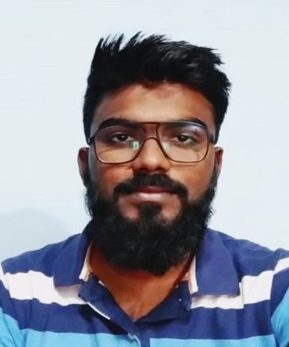
Arman Kashim Sakware
Photo Here
(Face to cover 50% of the box)
No Facebook Pics
Trainee Software Engineer
Mobile : 9637506191
Email: Arman.Sakware@mastek.com
Linkedin: https://www.linkedin.com/in/arman-sk-2174ba188
Educational Qualification: BE in Mechanical Engineering
CGPA/Overall Score: 6.5 CGPA
University: Mumbai University.
Technical Skills :Microsoft Azure , Microsoft .NET, MVC, Angular, node.js, HTML, CSS, JavaScript, SQL Server, Postgre SQL.
Domain Knowledge: Healthcare
Behavioural Trainings Completed:
E-mail Etiquette, Technical Trainings/Certifications:
Microsoft Certified: Azure Developer Associate, Full Stack
Academic Project Details
Problem Statement:Hospital Appointment Booking System.
In this busy world we don’t have the time to wait in infamously long hospital queues for booking appointments.
Solution Summary: Easy interface for patients .They can visit website and can Explore available treatments and book doctor’s appointment by filling some basic form.
Doctors can manage their appointment simply by logging in.
Technology used: Angular ,Node Express, node.js ,Bootstrap, Html ,CSS, JavaScript, Angular material.
Outcome: Attractive and responsive interface for Patient and doctors. For easy bookings and manage appointments for available treatments.The patient could see the available treatments and services and also the qualifications and proficiency of doctors on the website and could book appointments. Doctors could also manage the appointments

Slide 12
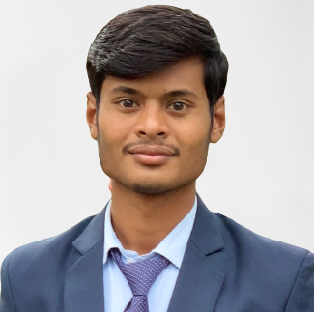
Aniket Yadavrao Waghmare
Trainee Software Engineer
Mobile : 7030977355
Email: Aniket.Waghmare@mastek.com
Linkedin: https://bit.ly/3jftCGX
Educational Qualification: Bachelor Of Engineering[CSE]
CGPA/Overall Score: 9.8
University: Sant Gadge Baba Amravati University
Technical Skills: C#, .NET, UI layer(CSS, HTML), Angular, Javascript, MySQL Database
Domain Knowledge: Education
Behavioural Trainings Completed:
Anti Bribery, InfoSec, GDPR, POSH
Technical Trainings/Certifications:
Angular, C Sharp, ASP, PostgreSQL, SQL Server, UI Layer
Academic Project Details
Problem Statement: Student Counselling System are often times are managed manually, so we decided to create Student counselling System.
Solution Summary: In this Website, we created features such as add student details, counsellor details, academic details.
Technology used: C#, Dot Net, MySQL Database
Outcome: We created Student Counselling Record System application Web Site with more features for online counselling record system.

